Slide 1
SHA Algorithm

Slide 2
Outline
Introduction
Abstract
Sponge construction
Keccak-Algorithm

Slide 3
Introduction
The Secure Hash Algorithm (SHA) was developed by the National Institute of Standards and Technology (NIST) and published as a federal information processing standard (FIPS 180) in 1993; a revised version was issued as FIPS 180-1 in 1995 and is generally referred to as SHA-1. The actual standards document is entitled Secure Hash Standard.
SHA-1 produces a hash value of 160 bits. In 2002, NIST produced a revised version of the standard, FIPS 180-2, that defined three new versions of SHA, with hash value lengths of 256, 384, and 512 bits, known as SHA-256, SHA-384, and SHA-512

Slide 4
What is a hash algorithm? • Function that compresses message of arbitrary length to m-bit digest Problem: • Difficult to assure collision resistance for arbitrary compression function f Message of arbitrary size m-bit digest

Slide 5
Abstract:
The Secure Hash Algorithm 3 (SHA-3) is the latest member of the secure hash family of algorithms (SHA) on top of which several technologies are built upon, such as in Blockchain, security applications and protocols, including TLS, SSL, PGP, SSH, IPsec, and S/MIME. Due to tighter processing and power efficiency constraints often present in embedded applications, hardware architectures such as FPGAs (Field-Programmable Gate Array) can be employed to enable the design and implementation of efficient hardware accelerators. Thus, this work implements a SHA-3 Co-Processor in FPGA suitable for IoT applications. Performance, Circuit-area and Energy consumption results show that the Co-Processor is about 65% faster than the ARM Cortex-A9 processor that is also equipped in the FPGA chip, as well as in many IoT embedded systems.
keccak is substantially faster in hardware

Slide 6
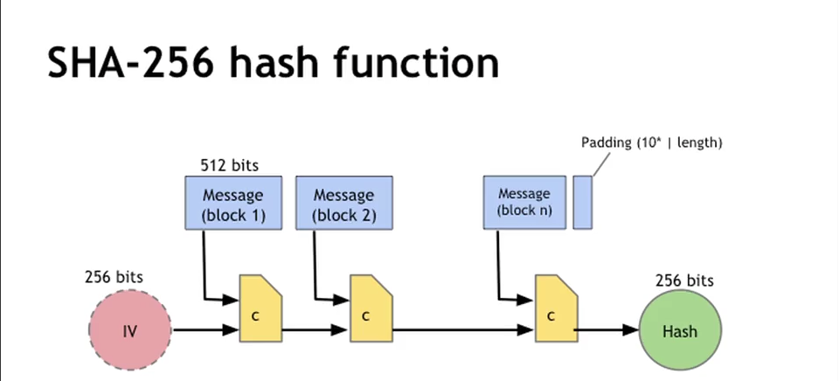
SHA-256

Slide 7
SHA-3 :
SHA3-256 provides more cryptographic strength than SHA-256 for the same hash length (256 bits). The SHA-3 family of functions are representatives of the "Keccak" hashes family, which are based on the cryptographic concept "sponge construction". Keccak is the winner of the SHA-3 NIST competition.
SHA-3 is considered highly secure and is published as official recommended crypto standard in the United States.
The hash function Keccak-256, which is used in the Ethereum blockchain, is a variant of SHA3-256 with some constants changed in the code.
The hash functions SHAKE128(msg, length) and SHAKE256(msg, length) are variants of the SHA3-256 and SHA3-512 algorithms, where the output message length can vary.
s

Slide 8
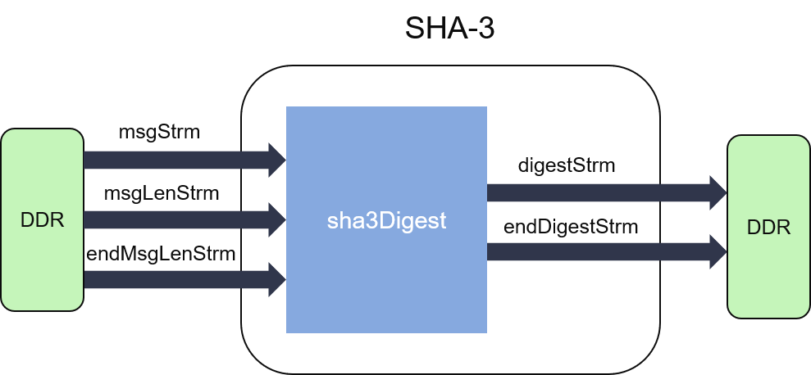

Slide 9
SHA-3
The SHA-3 competition
The sponge construction
Inside Keccak
The SHA-3 FIPS

Slide 10
SHA-3 Competition
First round: October 2008 to summer 2009
64 submissions, 51 accepted
37 presented at 1st SHA-3 candidate conf. in Leuven, February 2009
many broken by cryptanalysis
NIST narrowed down to 14 semi-finalists.
Second round: summer 2009 to autumn 2010
analysis presented at 2nd SHA-3 conf. in Santa Barbara, August 2010
NIST narrowed down to 5 finalists.
Third round: autumn 2010 to October 2012
analysis presented at 3rd SHA-3 conf. in Washington, March 2012.
October 2, 2012: NIST announces Keccak as SHA-3 winner

Slide 11
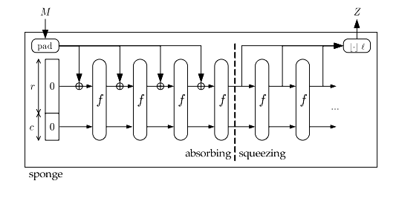
Sponge Construction
Generalizes hash function: extendable output function (XOF).
Calls a b-bit permutation f, with b = r + c
r bits of rate
c bits of capacity (security parameter)

Slide 12
Breaking the input data to be hashed into r-bit sized chunks, in SHA-3’s case the rate+capacity bits sum up to 1600 bits.
The first input rate and capacity are all zeros and are XORed with the first rate block r₁
The combined rate and capacity block is put through a function, usually of multiple rounds.
The first r-bits of the function are rate and the remaining c-bits capacity.
The above r-bits are XORed with r₂ and fed into another function
This is done until there are no left over data blocks.
On the last data block, the hash is taken from r-bits output of the function.
If more bits are needed the above rate and capacity are fed through the function without inputing any additional data.

Slide 13
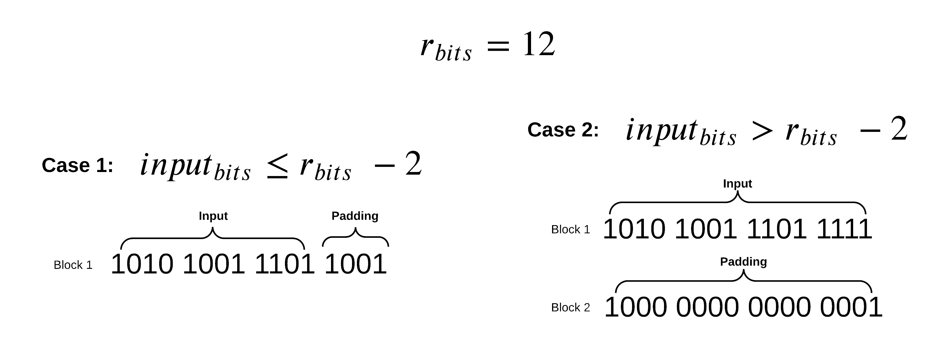
Padding
Since data is rarely perfectly divided into an equal number of blocks perfectly, SHA-3 must pad the input data to be perfectly divisible by r-bits. This padding is done by adding a 1 bit, then filling in with zero or more 0’s and then ending with a 1 bit. The two cases for input padding are described below.

Slide 14
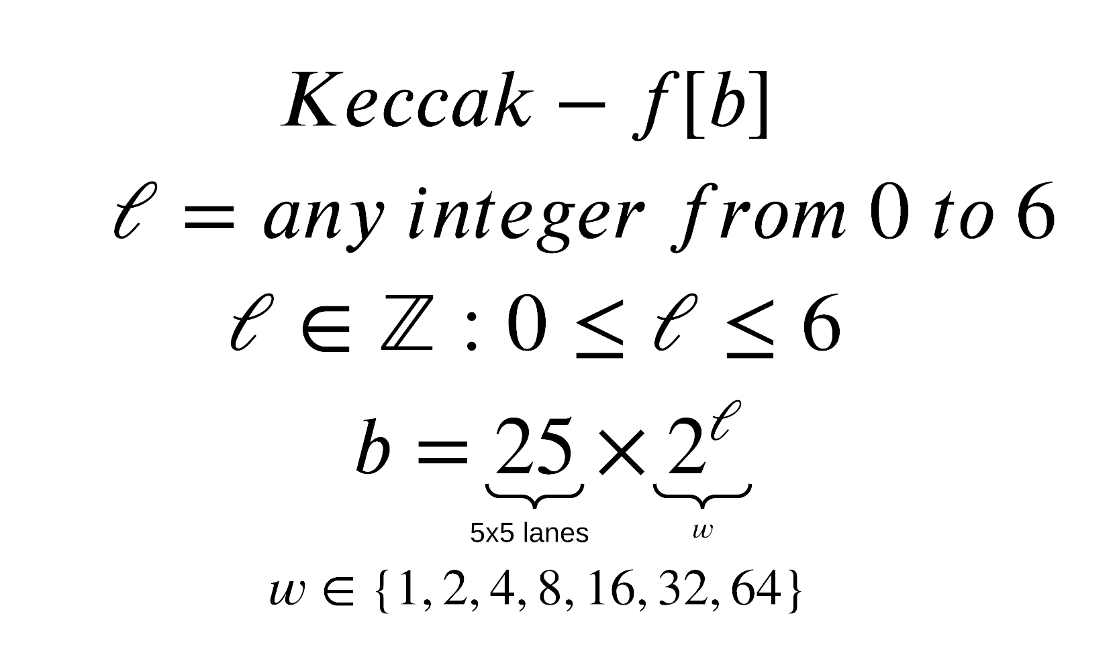
The Keccak Function
The Keccak function is the heart of SHA-3, this function is the function block in the above diagram, it uses XOR, AND and NOT operations which translate into easy implementation in both software and hardware scenarios.
∈ – Element of, means that it is a part of the next set of numbers
ℤ – Represents the family of Integers
b – number of bits the function takes
ℓ – is any integer from 0 to 6, the main SHA-3 implementation uses a ℓ value of 6.

Slide 15
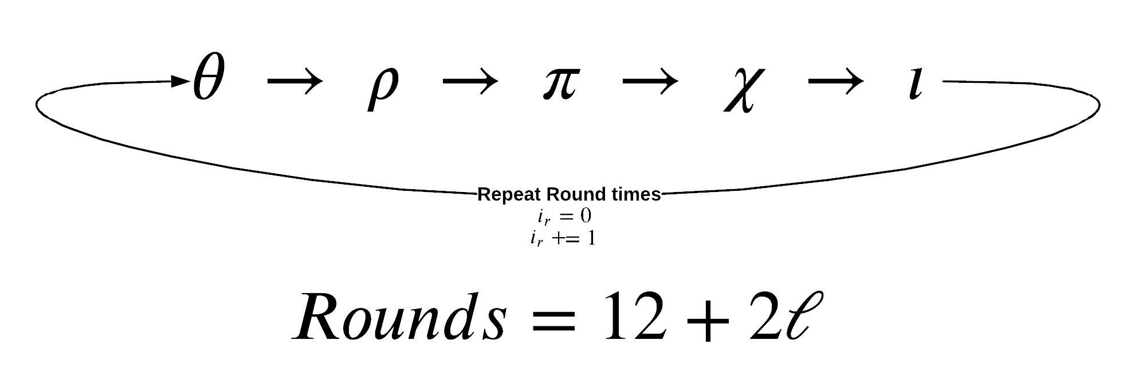
The Block Transformation
The block transformation, which is represented as the block labeled function in the above sponge function diagram is broken up in to 5 steps that are done a number of rounds.
In SHA-3 we have 24 rounds.

Slide 16
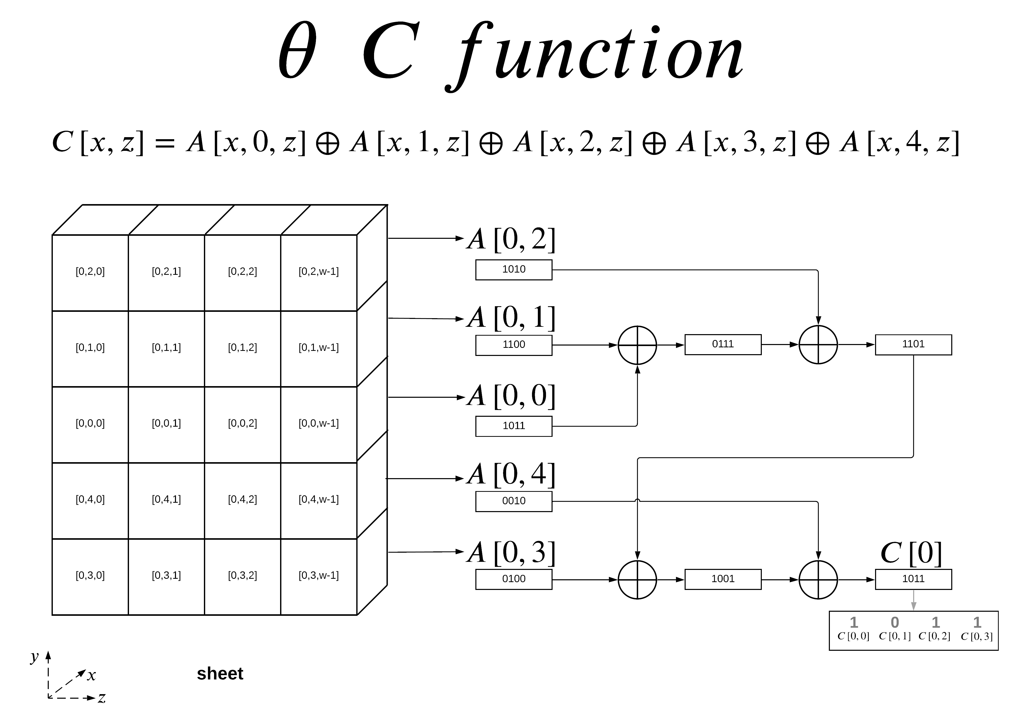
The 5 steps are: θ (theta) ρ (rho) π (pi) χ (chi) ι (iota)
The θ (theta) Step
The θ step consists of two separate functions, the C function and the D function.
θ C Function
The C function is probably one of the easiest to grasp conceptually. It consists of 4 stages of consecutive XOR calculations.

Slide 17
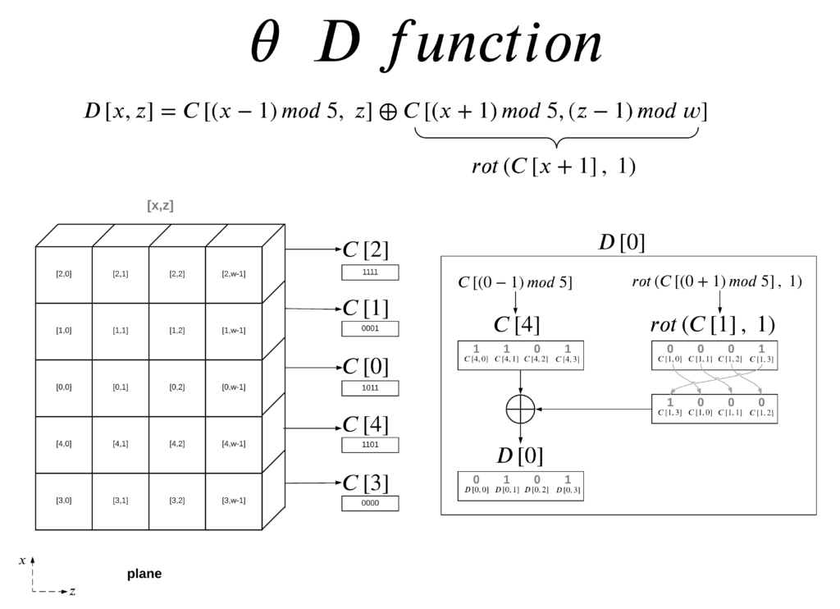
θ D Function
The D function introduces cross slice diffusion via the right bitwise rotation with respect to z. It takes two offset C function outputs and XOR’s them together.
For D[0], you can see that it does not use C[0], it actually uses the x+1 and x-1 offset of of C[0]. This provides diffusion across the x-direction.
The second argument to the D function offsets z by one position, while you can just do z-1 when calculating an individual bit, when you calculate an entire lane we can represent this z offset as a right-rotation. This provides diffusion across the z-direction.
The final step is to XOR both arguments together, giving you D[0] the lane representation of the D function output for x=0. The mapping per bit is broken down for D[0] to show mapping per bit.

Slide 18
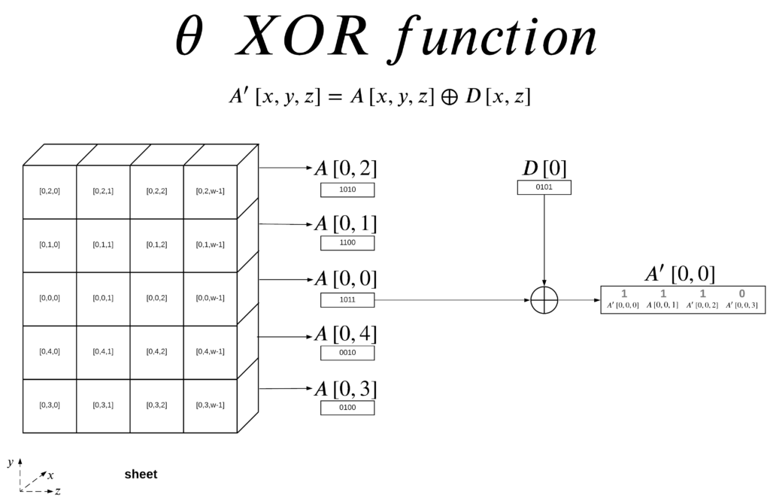
θ Output The output of the theta function is the XORed result of the initial state array A and the output of the D function.

Slide 19
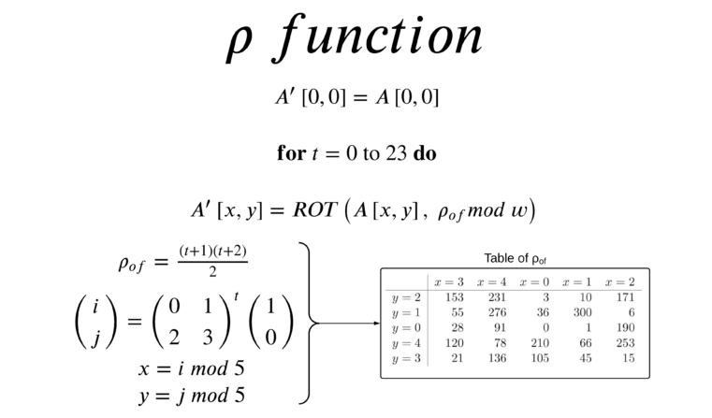
The ρ (rho) Step The ρ step thankfully only consist of one step. This step is conceptually easy to apply but difficult to understand when written in math notation. We will use A as the input state and A’ as the modified state. In this case A is the output from the final θ step above.
Basically for A[0,0] you rotate it 0-bits so it stays the same. To find the rotation for A[0,2] we look at the table and find where x=0 and y=2 intersect, in this case we get 3. We will then rotate the bits in lane A[0,2] by 3-bits to the right, this is visually represented by a dot (its initial position) with an arrow pointing to a grey box (its final position). I also gave a visual representation of the rotation for A[0,2]. This rotation is then preformed on all lanes in the 5-by-5-by-w state.

Slide 20
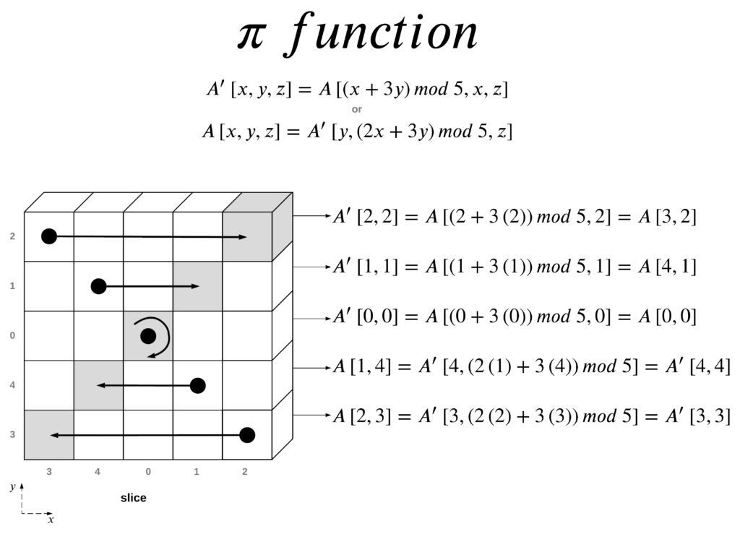
The π(pi) step:

Slide 21
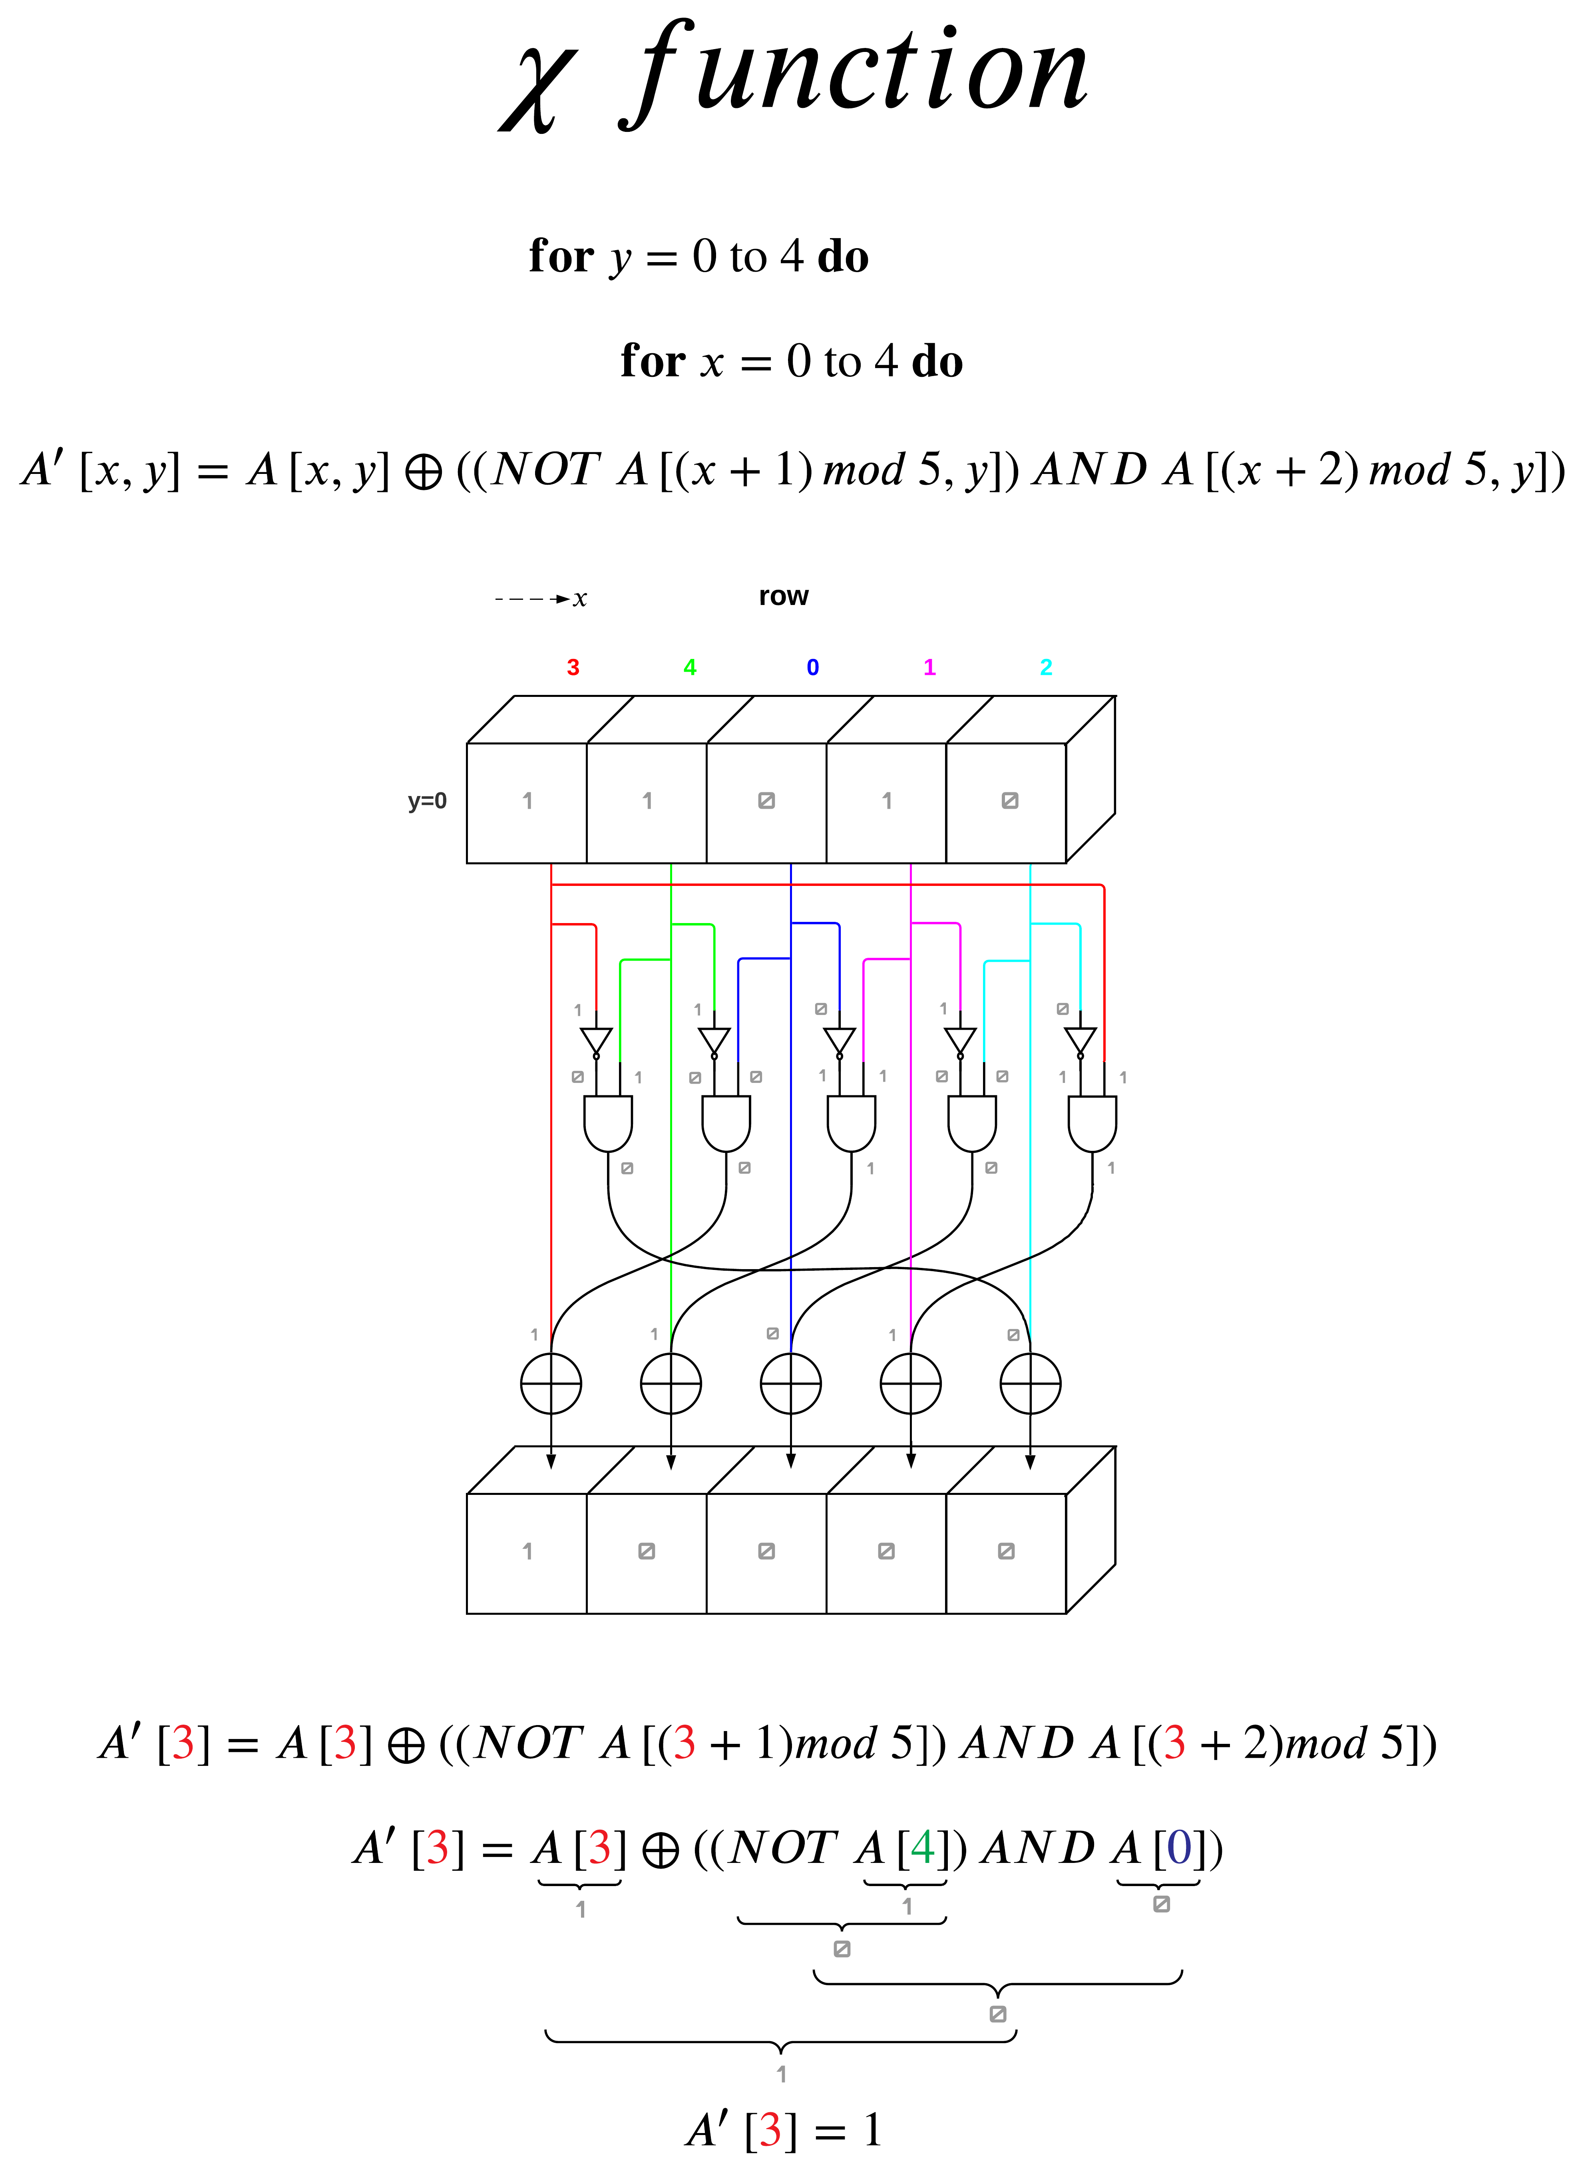
The χ (chi) Step The χ step is the only nonlinear mapping step in. It consists for XOR, NOT, and AND operations with bits across the x-direction and is applied to a plane at a time.

Slide 22
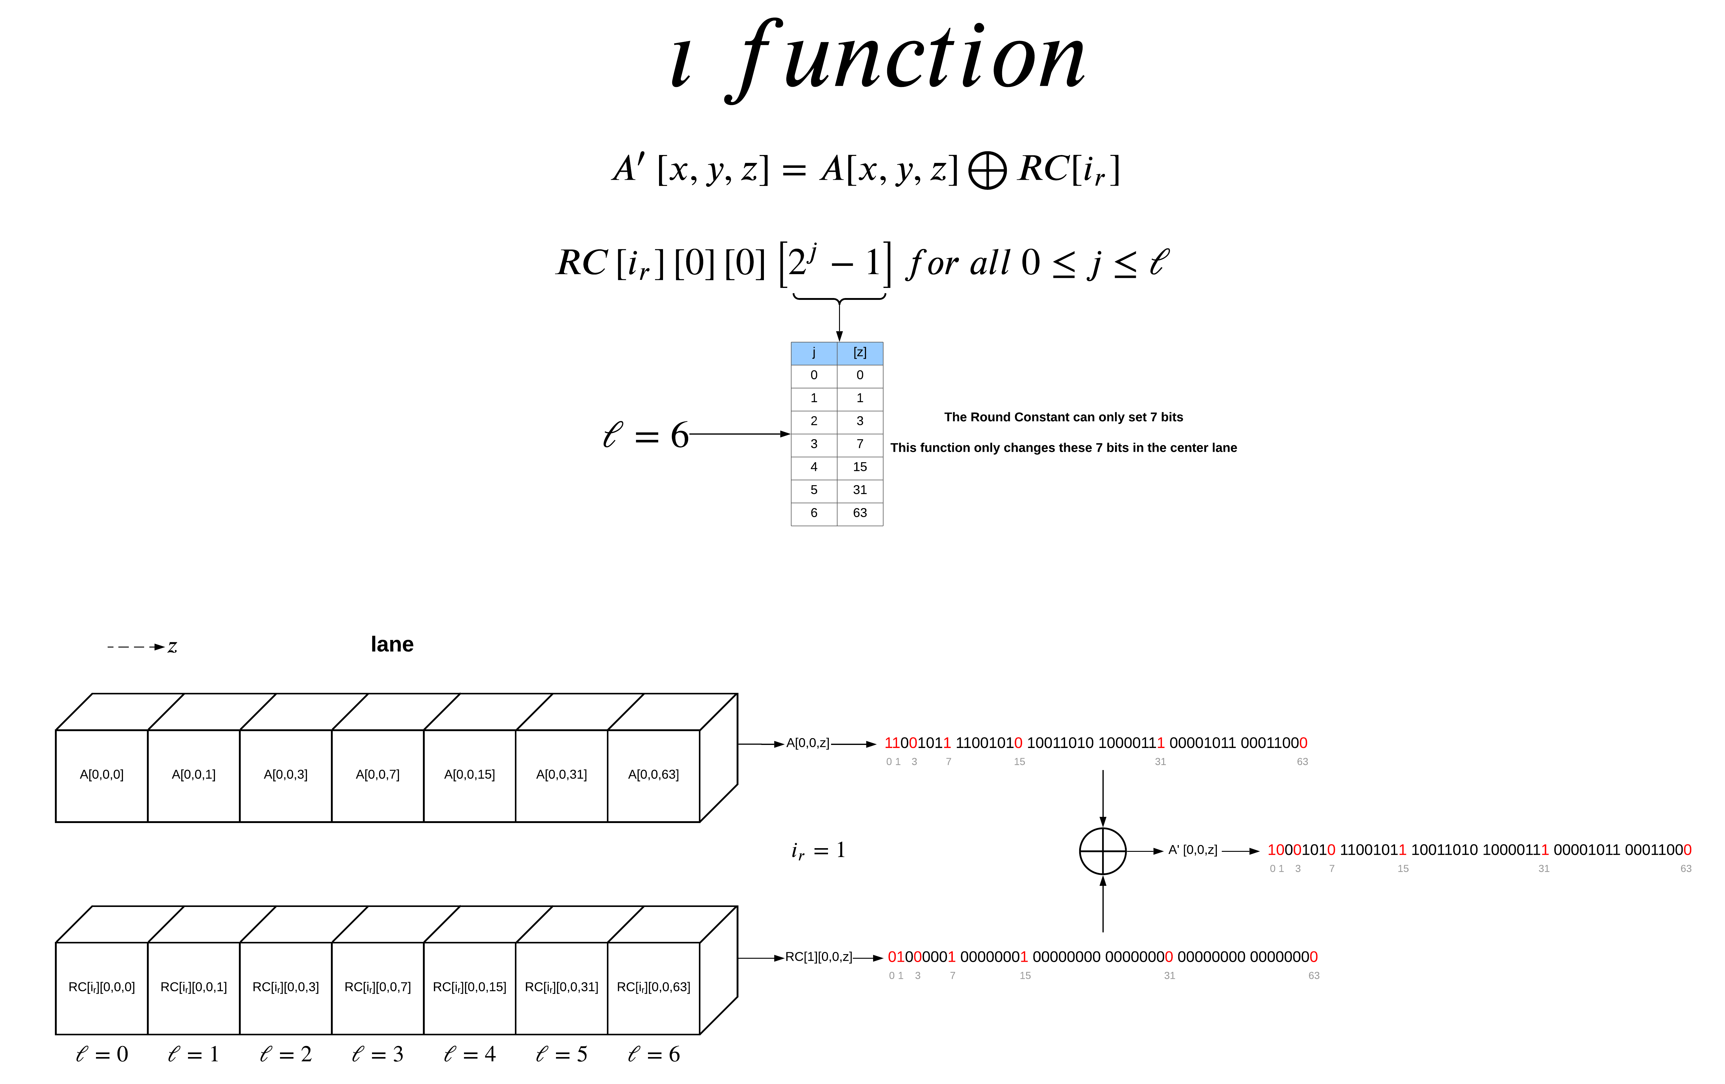
The ι (iota) Step The ι step is the most simple of all the steps. The purpose of the ι step is to modify some of the bits of Lane(0,0), the other 24 lanes are not affected by ι. This is done by XORing Lane(0,0) by the round constant (RC[i_{r}]). Although the ι step is the most simple, it took me the longest to understand, specifically understanding how to generate the round constant vs using the supplied table.

Slide 23
After the ι step i_{r} is incremented by 1 and the output of the ι step is the new input to the θ step. Once i_{r} is 24 the output of the ι step is the new rate and capacity. This new state is then XORed with any remaining rate chunks and fed into the function again. See the Sponge Construction section for next steps.

Slide 24
thank you

